Slide 1
ELEMENTARY STATISTICS, BLUMAN
Area Under Normal Curve Using Table (Example 2)
© 2019 McGraw-Hill Education. All rights reserved. Authorized only for instructor use in the classroom. No reproduction or further distribution permitted without the prior written consent of McGraw-Hill Education.

Slide 2
Objectives for this PowerPoint
Learn how to find probabilities associated with a normally distributed variable using the normal distribution table.

Slide 3

Example (1)
Using the standard normal distribution find the probability that a randomly selected standardized value from a normally distributed variable is greater than 2.33.
$$P(z>2.33)$$

Slide 4
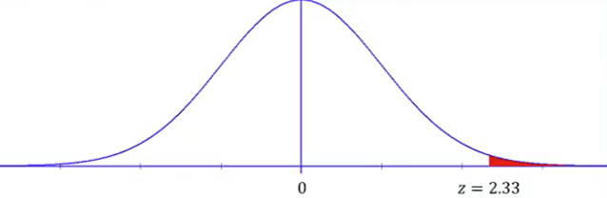
Example (2)
This can also be described as finding the area under the normal curve above 2.33 standard deviations to the right of the mean.

Slide 5
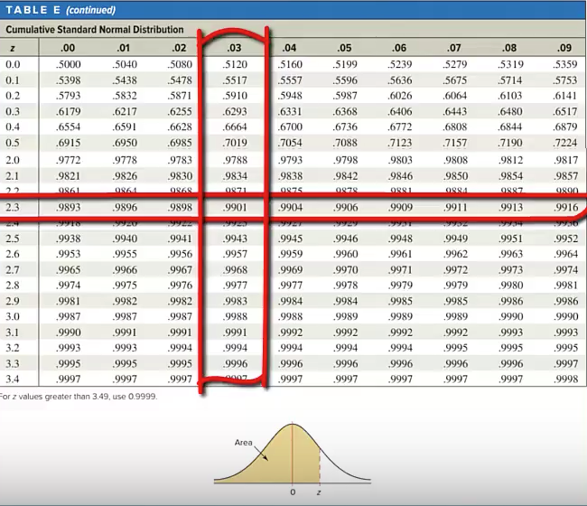
Example (3)
The cumulative standard normal distribution table gives us probabilities associated with z-scores. We are looking for the probability associated with the z-score 2.33. We will find the entry in the table where the row 2.3 intersects with the column .03.
We find this value to be .9901

Slide 6
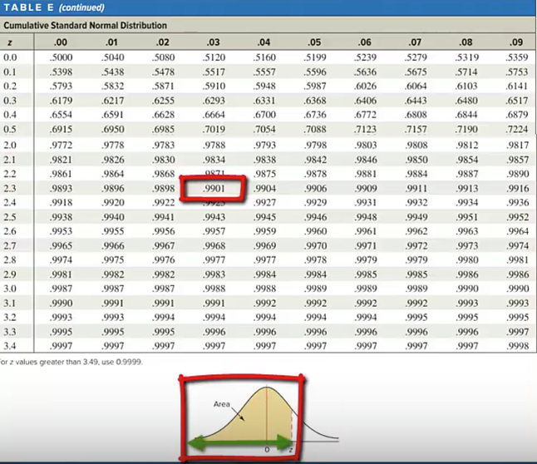
Example (4)
The graph at the bottom of the table shows that these 4 decimal place values in the body of the table correspond to the area under the curve that extends from the left tail up to the z-value.

Slide 7
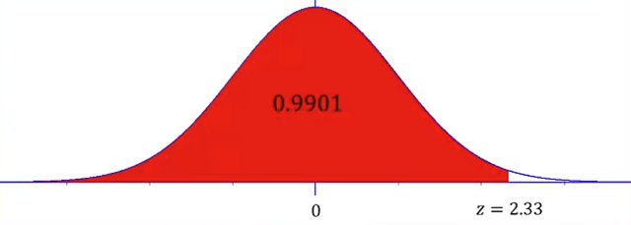
Example (5)
This value 0.9901 would correspond to the area under the curve that extends from the left-tail to the z-value 2.33.

Slide 8
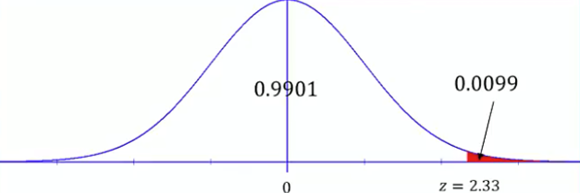
Example (6)
But our requested probability calls for the area that extends from the z-value 2.33 up through the right-tail. The total area under the curve is 1. The area under the curve to the right of where the z-score is 2.33 would be 1 minus 0.9901 that would leave 0.0099 as the area under the curve to the right of z equal to 2.33.

Slide 9

Example (7)
In probability notation we would write the following:
$$P\left(z>2.33\right)=1−0.9901=0.0099$$

Slide 10
Summary
In this PowerPoint we learned how to find probabilities associated with a normally distributed variable using the normal distribution table.

